Slide 1
Final Engagement
Attack, Defense & Analysis of a Vulnerable Network
Prepared by Eric Loi
Team members: Md Iftakher Hossain, Lucas Domanski, Eric Loi
May 6th, 2021

Slide 2
Table of Contents
This document contains the following:
Network Topology & Critical Vulnerabilities
Alerts Implemented
Hardening

Slide 3

Network Topology
& Critical Vulnerabilities
3

Slide 4
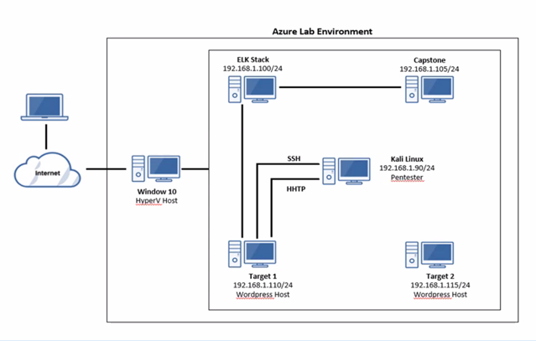
Network Topology
Network
Address Range:192.168.1.0/24
Netmask:255.255.255.0
Gateway:192.168.1.1
Machines
IPv4:192.168.1.90
OS:Debian Kali 5.4.0
Hostname:Kali
IPv4:192.168.1.100
OS:Ubuntu 18.04
Hostname:ELK Stack
IPv4:192.168.1.105
OS:Ubuntu 18.04
Hostname:Captoe
IPv4:192.168.1.110
OS:Debian GNU/Linux 8
Hostname:Target 1
IPv4:192.168.1.115
OS:Debian GNU/Linux 8
Hostname:Target 2

Slide 5
Critical Vulnerabilities: Target 1
Our assessment uncovered the following critical vulnerabilities in Target 1.
Vulnerability | Description | Impact
Insecure MySQL Database | The hashed passwords for the users are stored in MySQL database, access to the MySQL databased was not restricted. | MyQL database dump was not restricted, can gain user password hashes, tools can be used to cracked the hashes.
Malware | Virus can easily penetrate the system | Virus can caused service interruption, and having sensitive data stolen.
Weak Password | A user has simple password that can easily cracked. | This password can be brute forced or easily guessed.
Code Injections | Malicious code could inject to carried out attacks | Result malicious data were sent to the server to carry out the attack,

Slide 6
Alerts Implemented
6

Slide 7
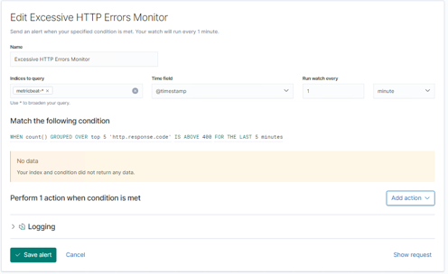
Excessive HTTP Errors Alert
Summarize the following:
Metric: WHEN count() GROUPED OVER top 5 'http.response.status_code'
Threshold: ABOVE 400

Slide 8
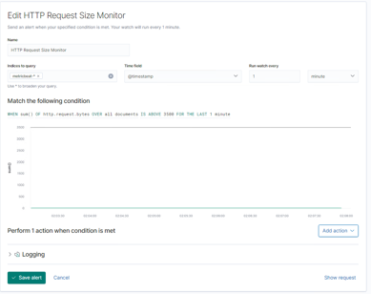
HTTP Request Size Monitor Alert
Summarize the following:
Metric: WHEN sum() of http.request.bytes OVER all documents
Threshold: ABOVE 3500

Slide 9
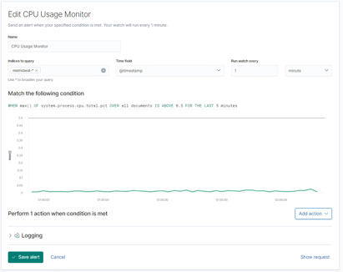
CPU Usage Monitor Alert
Summarize the following:
Metric: WHEN max() OF system.process.cpu.total.pct OVER all documents
Threshold: ABOVE 0.5

Slide 10
Hardening
10

Slide 11
Hardening Against WordPress on Target 1 (1/2)
Why It Works:
Keeping updated patches to WordPress, the PHP version and plugins is the easiest way to mitigate exploits/vulnerabilities.
Wordfence can also provide the following protection:
Malware scans
Firewall
IP options (to monitor/block suspicious traffic)

Slide 12
Hardening Against WordPress on Target 1 (2/2)
How to install it (include commands)
To apply Wordpress updates with the following command:
wp core update --version=VERSION_NUMBER –force
To apply Wordfence:
Log into your WordPress admin.
In the left-hand menu, choose Plugins > Add New.
Type wordfence into the top-right Search Plugins box and press Return.
Find Wordfence Security – Firewall & Malware Scan in the search results, and click its Install Now button:

Slide 13
Hardening Against Weak Passwords on Target 1
Why It Works
Having complex password with Upper & Lower Case Alphabet, special characters and number, with minimum length of 10 make brute forcing more difficult. No patches will be required.
How to install it (include commands)
Edit /etc/pam.d/common-password file
To increase password to 10 characters add “minlen=10” to at this command line “ password [success=2 default=ignore] pam_unix.so obscure sha512 minlen=10”
Add “ucredit=-1” to at this command line “ password [password requisite pam_pwquality.so retry=3 dcredit=-1”

Slide 14
Hardening Against Malware on Target 1
Why the patch works.
Antiviruses specialize in removal, detection and overall prevention of malicious threats against computers.
Schedule scanning can remove known malicious viruses.
How to install it (include commands)
To apply antivirus software: sudo apt-get install [antivirus_software]

Slide 15
Hardening Against Code Injection on Target 1
Why the patch works.
WAF applies a set of rules to the communication within the HTTP/HTTPS/SOAP/XML-RPC/Web Service layers and help to filter out malicious data and requests.
How to install it (include commands)
https://kifarunix.com/install-and-configure-naxsi-nginx-waf-on-ubuntu-18-04-lts/

